Slide 1

Logo project – Julia Człapa - Poland

Slide 2
Holiday view of the world - competition

Slide 3
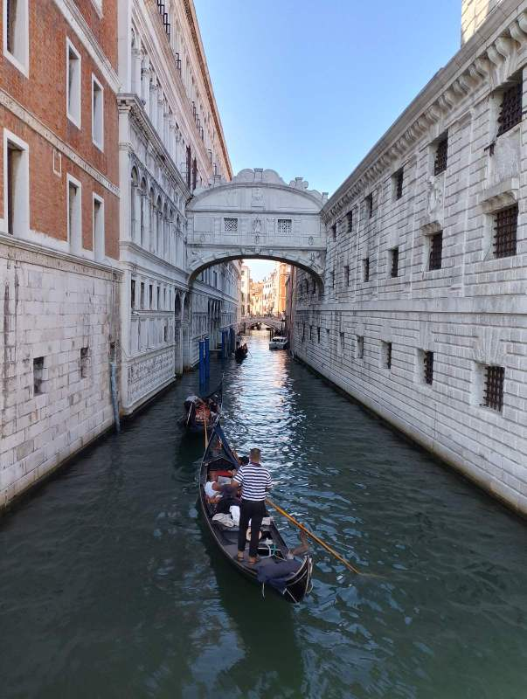
V Place – Basilis Manioudakis - Greece

Slide 4
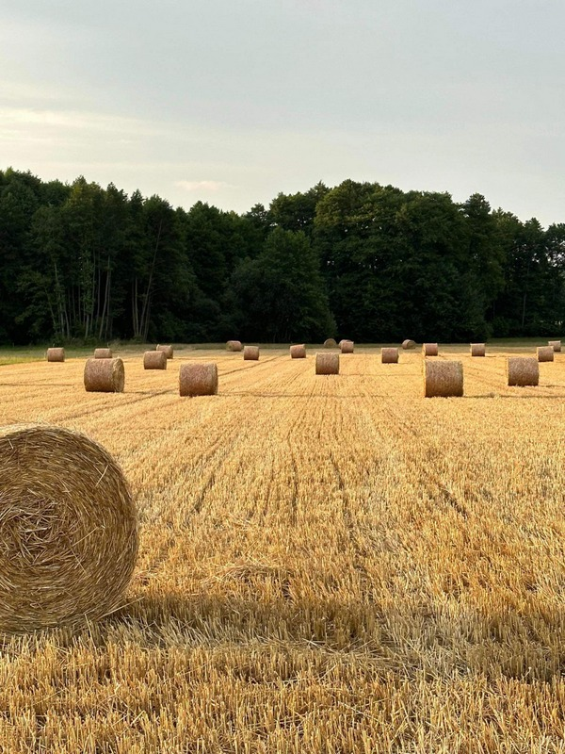
IV Place – Nela Gogulska - Poland

Slide 5
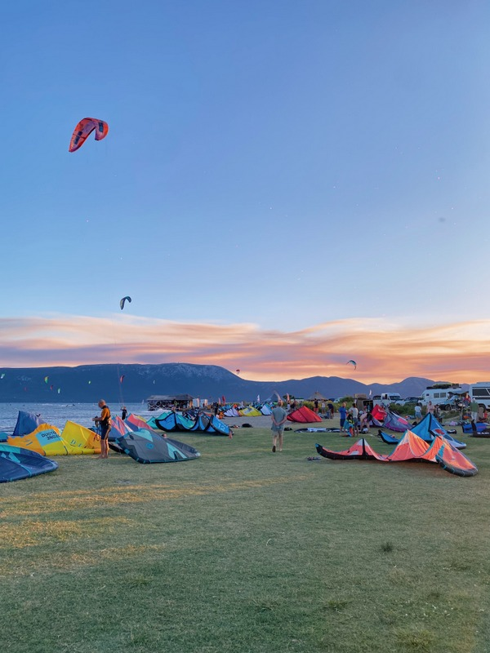
III Place – Frida Šuman - Croatia

Slide 6
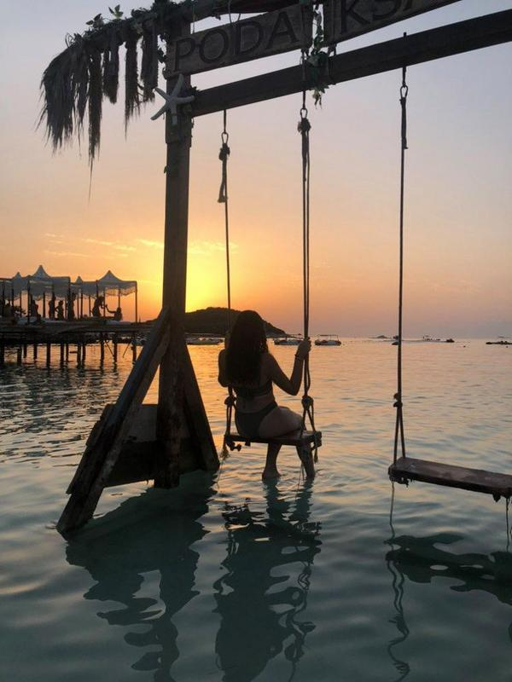
II Place – Ludovica Privitera - Italy

Slide 7
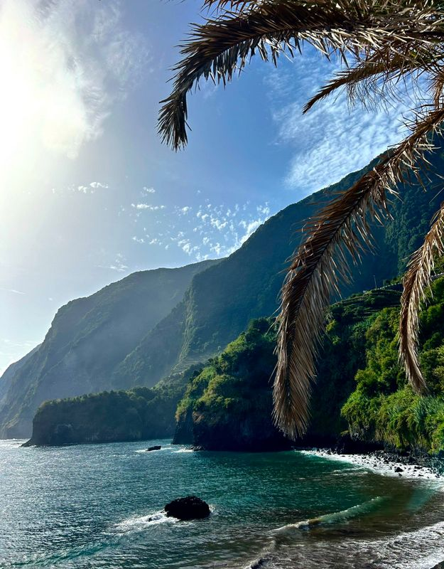
I PLACE – Julia Rodrigues - Portugal

Slide 8
Bowling competition

Slide 9
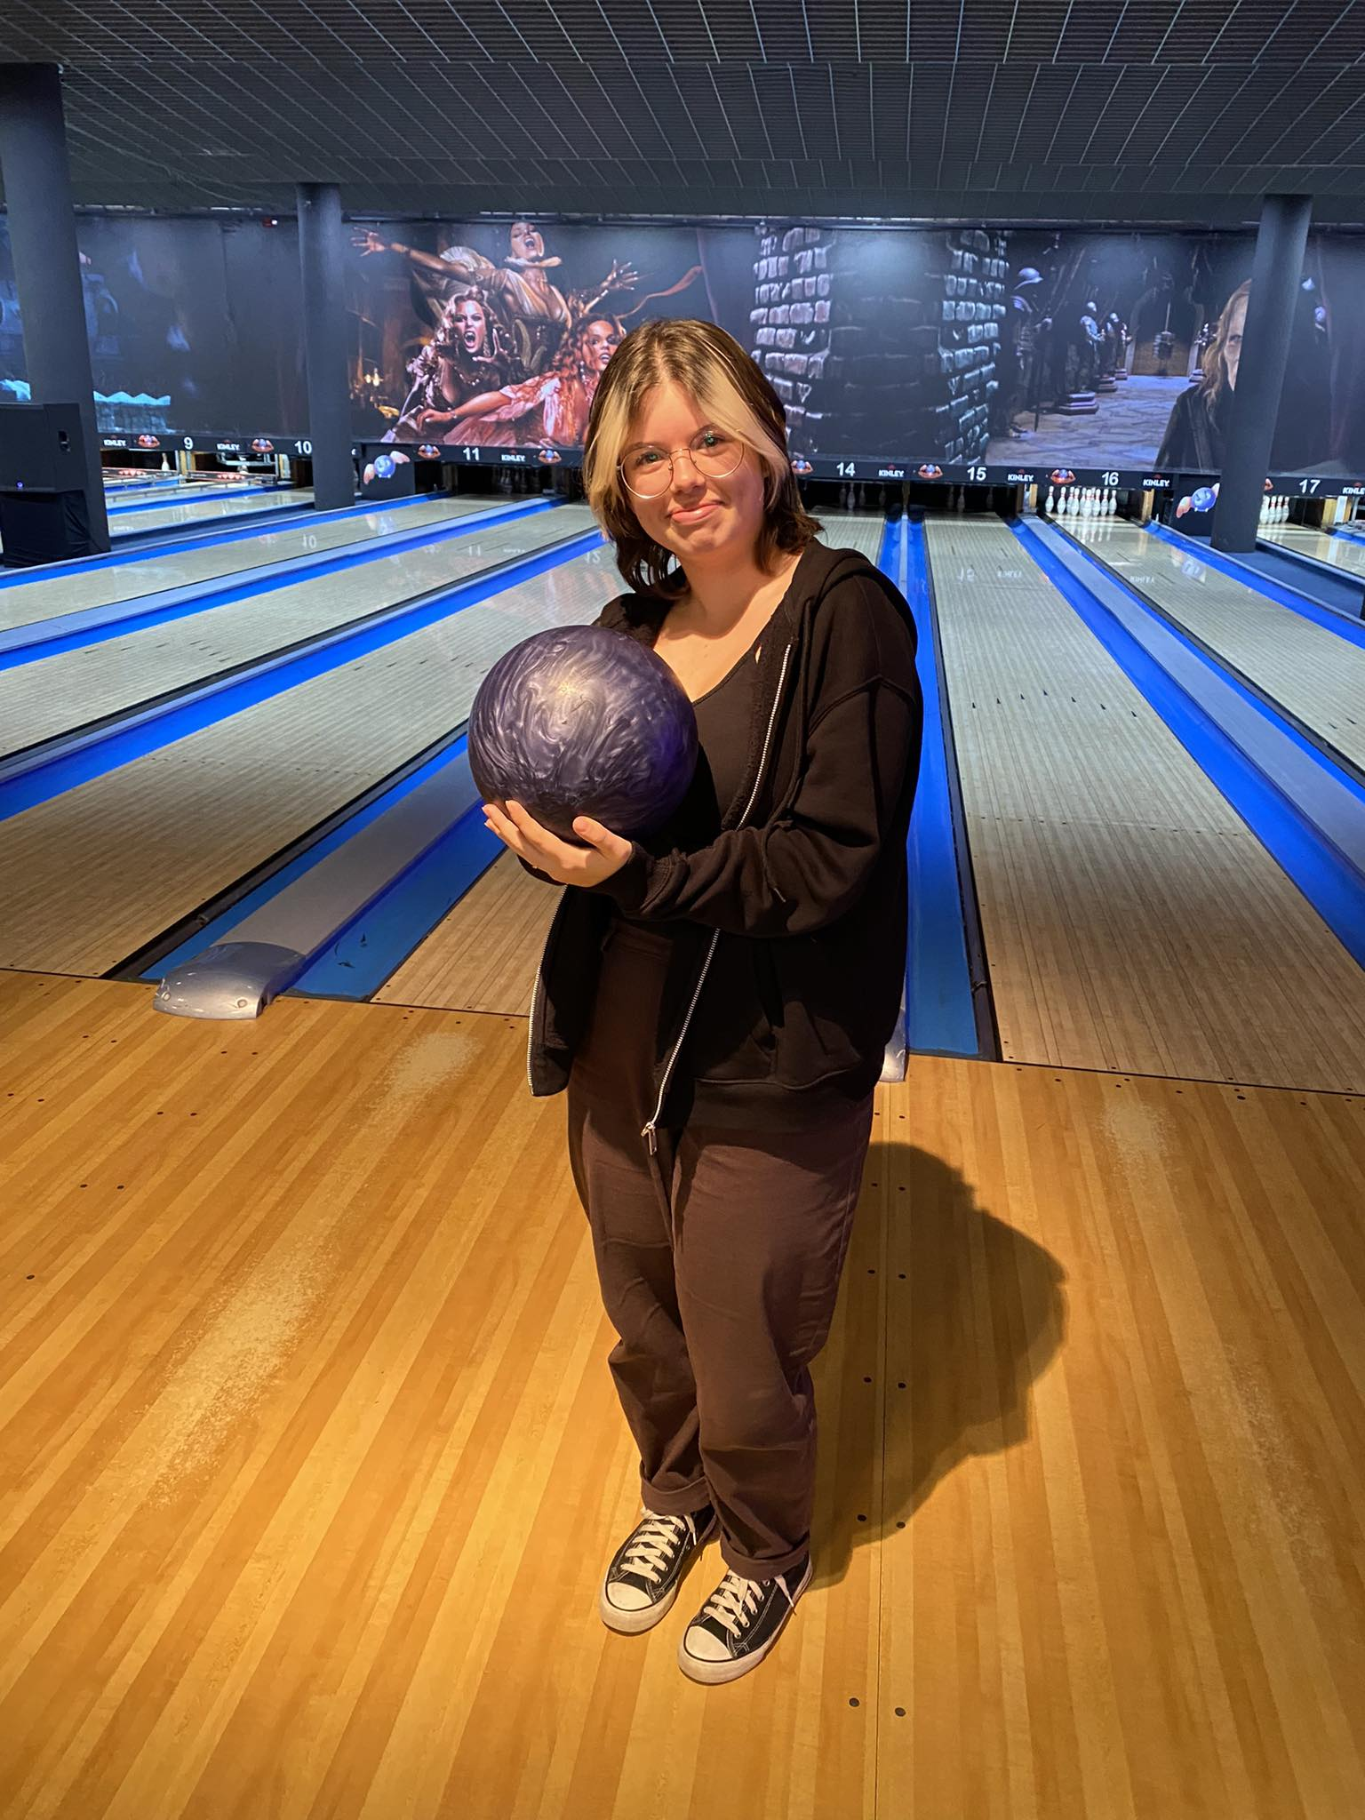
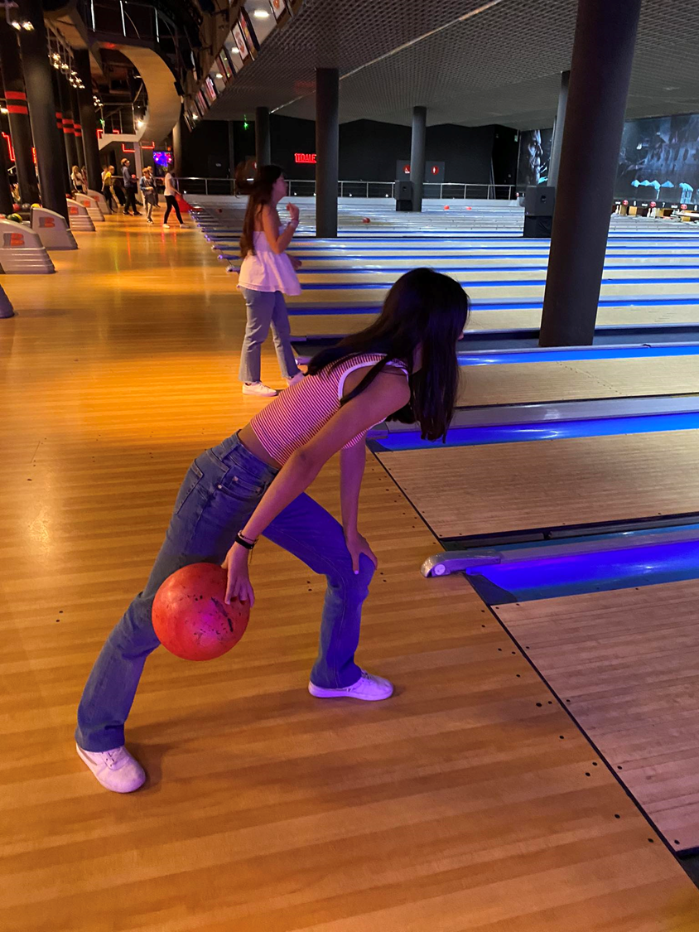
III Place – Olga Kwiatkowska - Poland and Sara Gavina – Portugal – 91 points

Slide 10
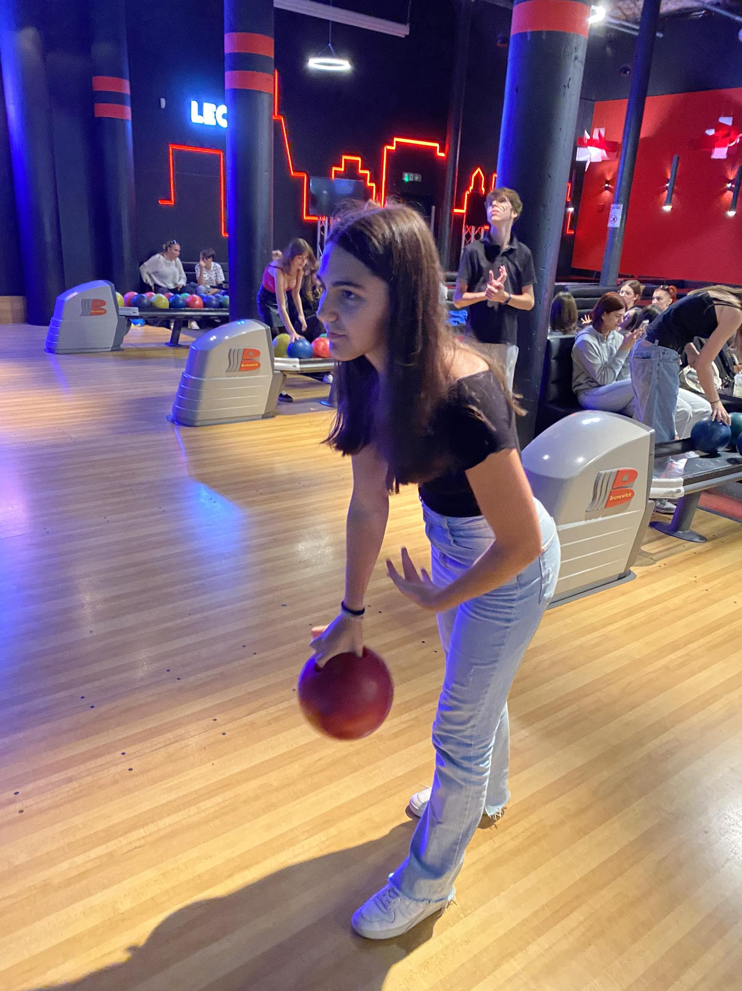
II Place – Carolina Castro – Portugal – 99 points

Slide 11
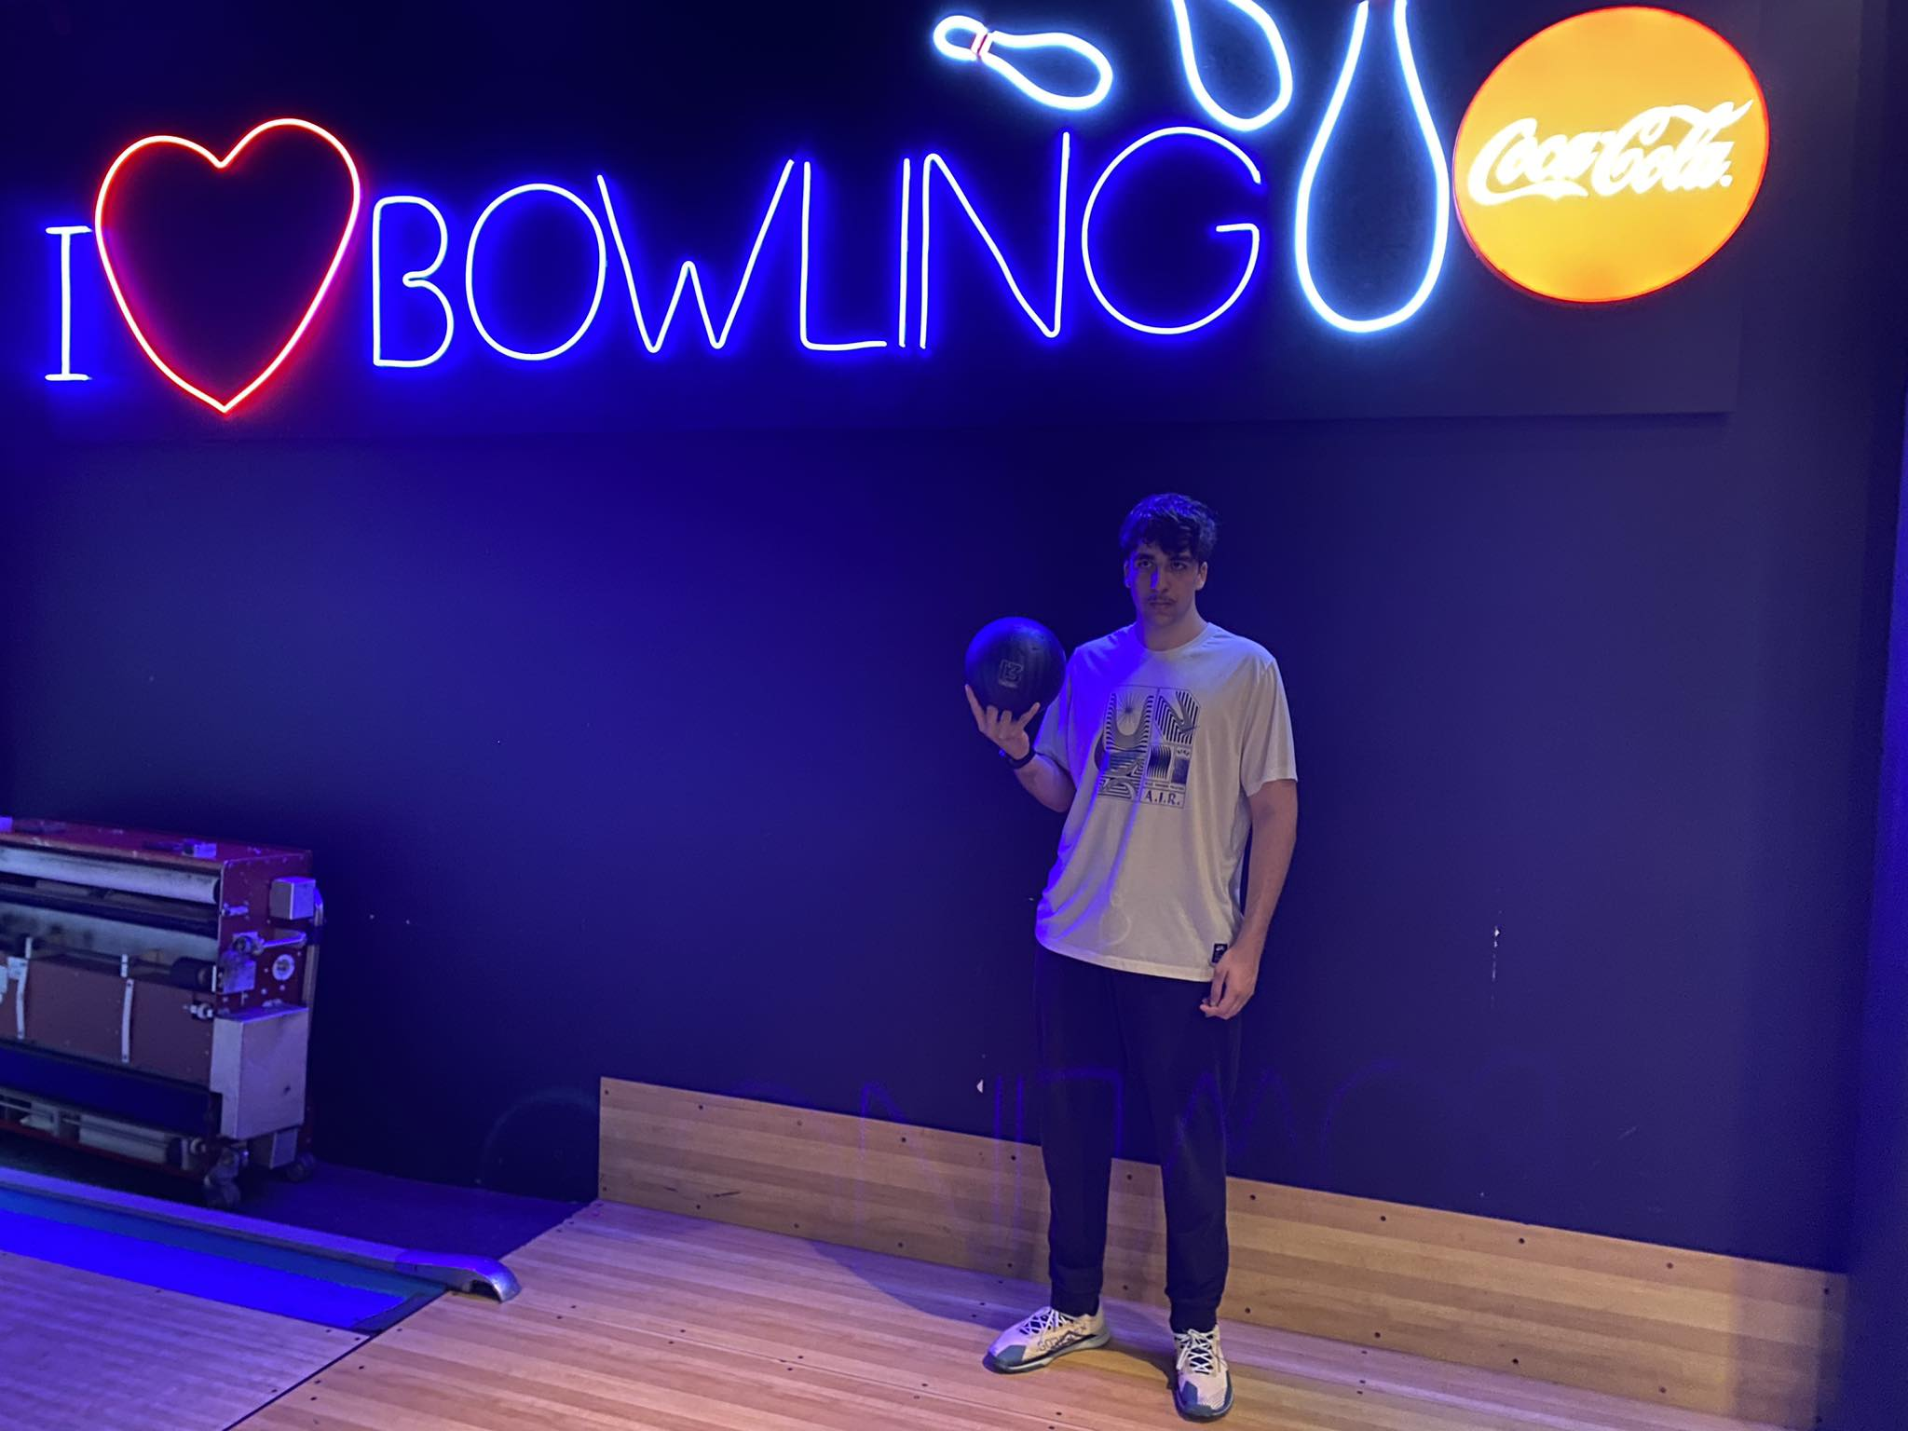
I PLACE – Emmanouil Vourtsis - Greece – 126 points

