Slide 1

Feelings - competition

Slide 2
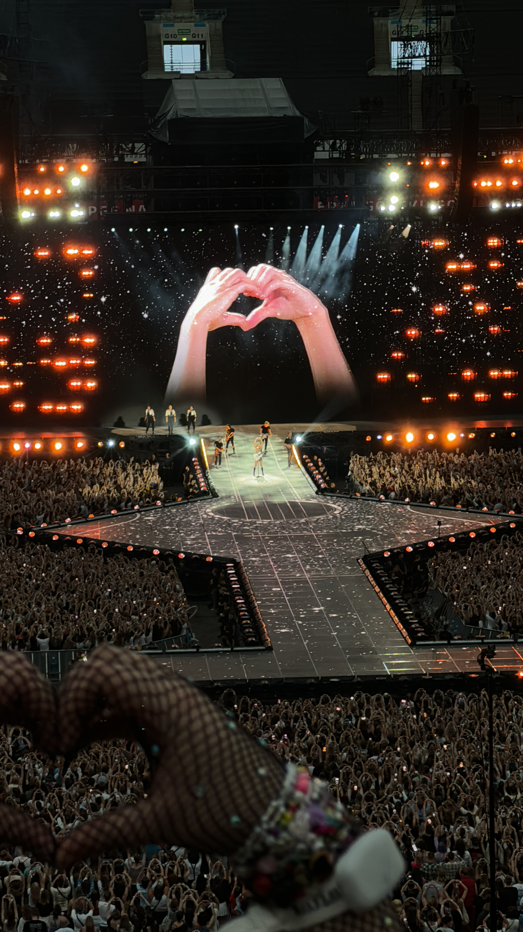
V Place – Olga Kwiatkowska - Poland

Slide 3
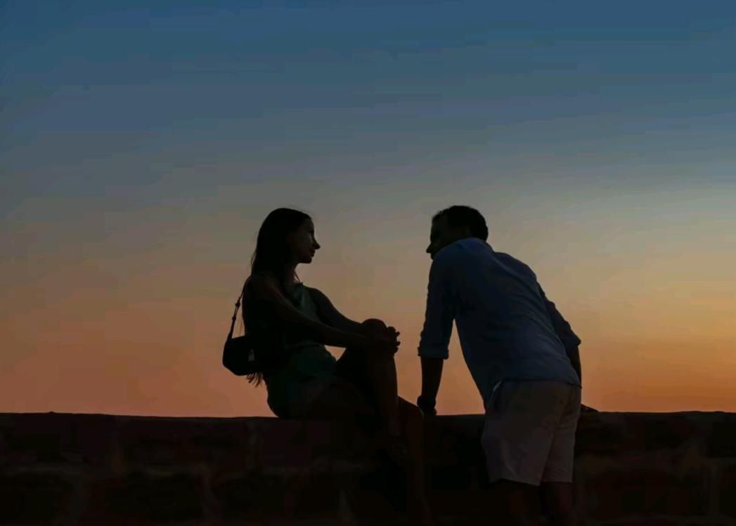
IV Place – Sofia Tavolacci - Italy

Slide 4
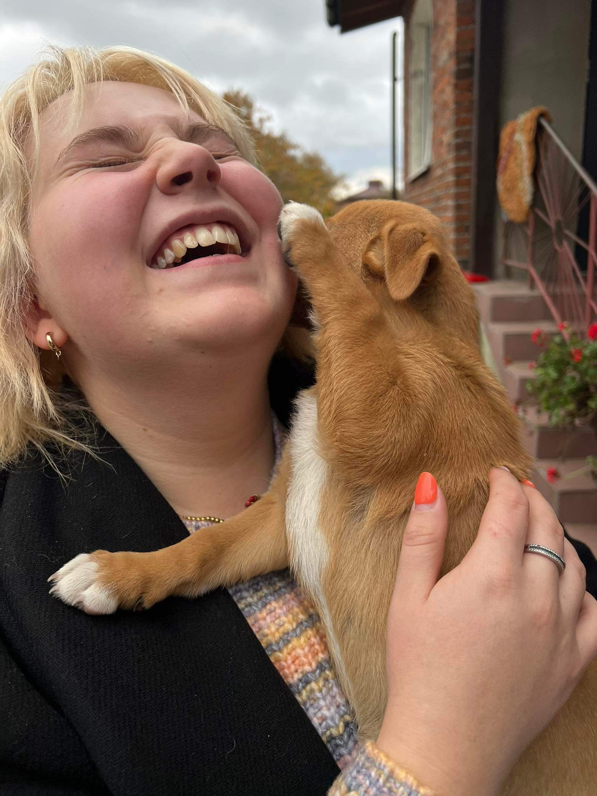
III Place – Zuzanna Piotrowska – Poland

Slide 5
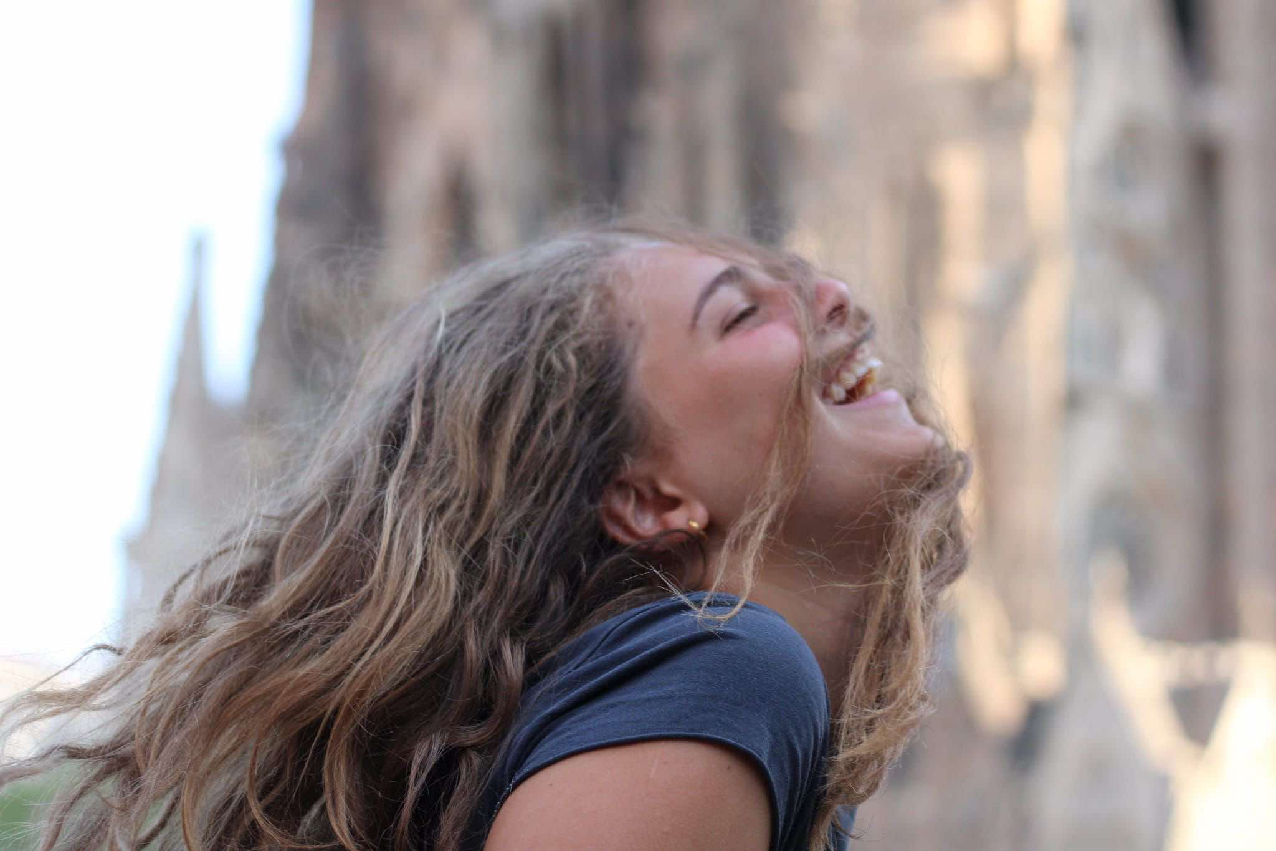
II Place – Lavinia Marletta - Italy

Slide 6
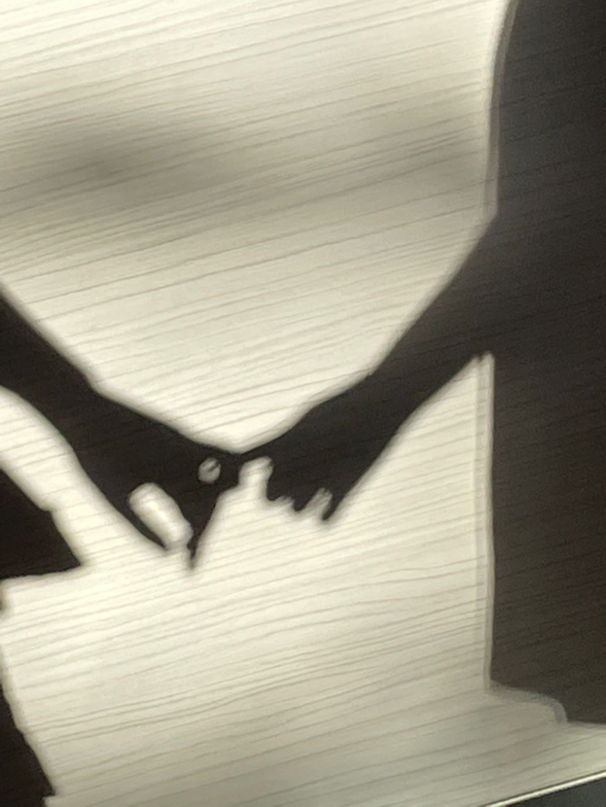
I Place – Matthew La Rosa – Italy

