Slide 1

A Christmans view of the world - competition

Slide 2
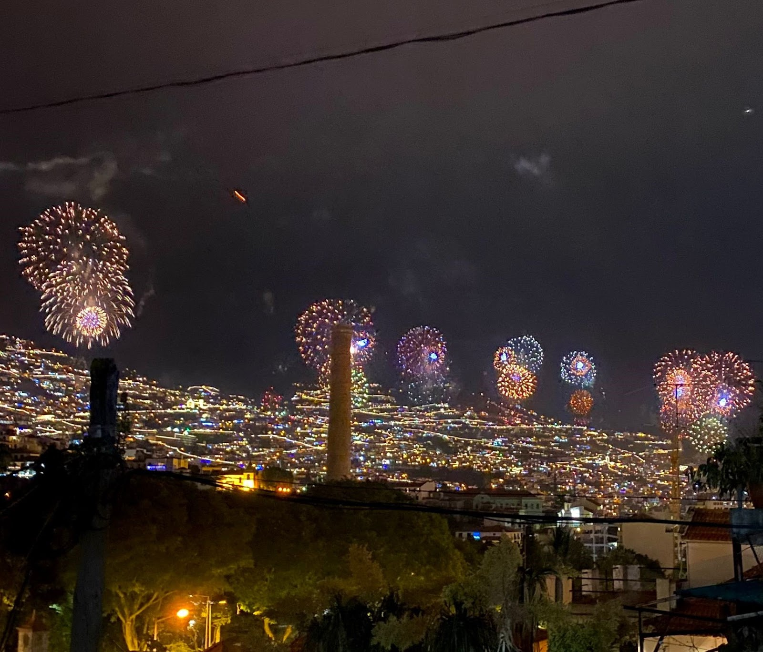
V Place – Maria Helena Pimenta - Portugal

Slide 3
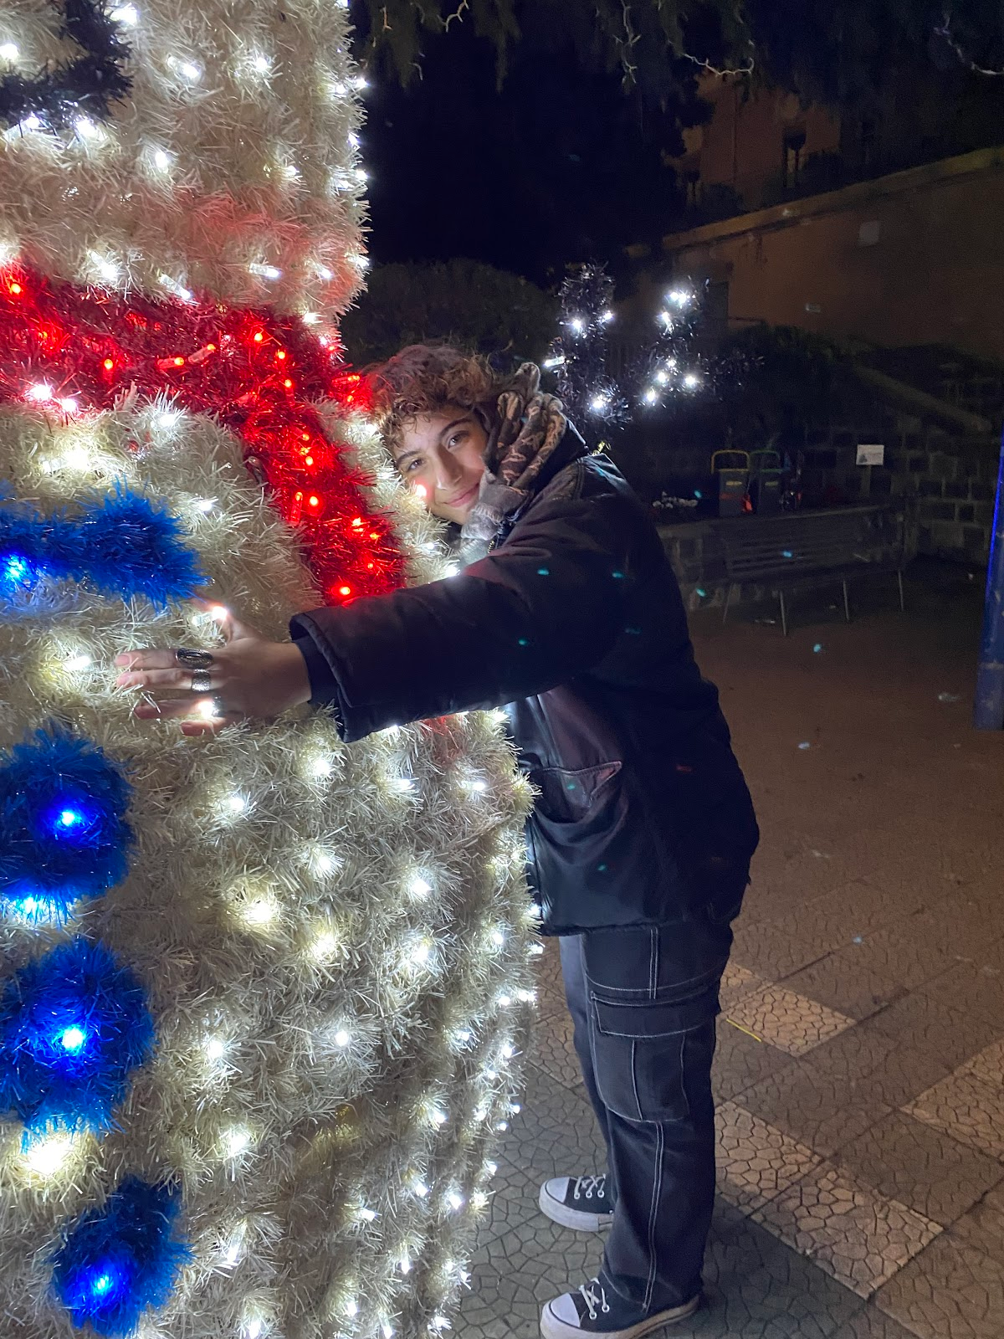
IV Place – Erika Parasilti - Italy

Slide 4
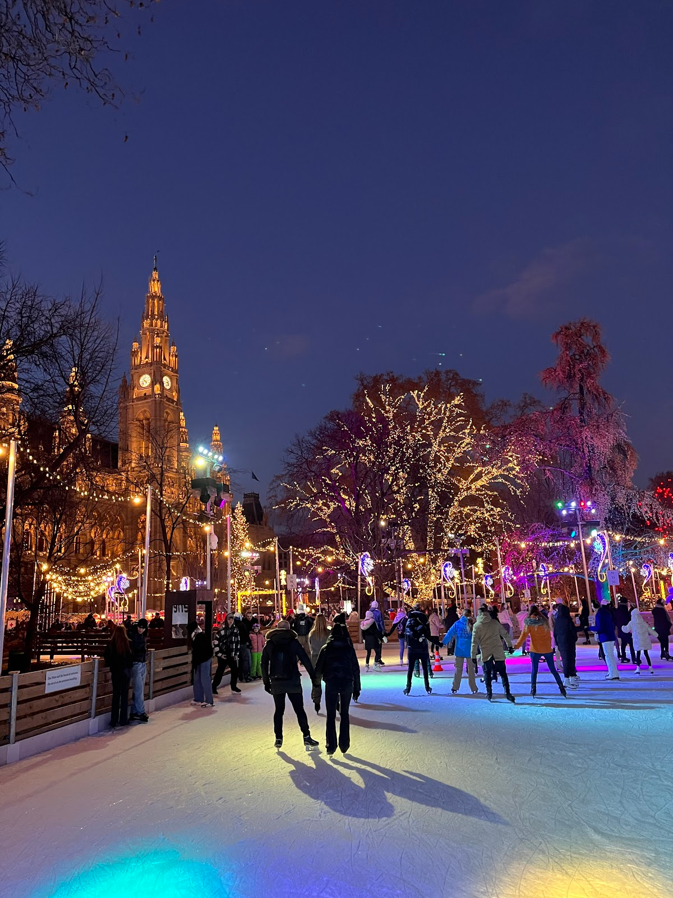
III Place – Silvio Kavelj - Croatia

Slide 5
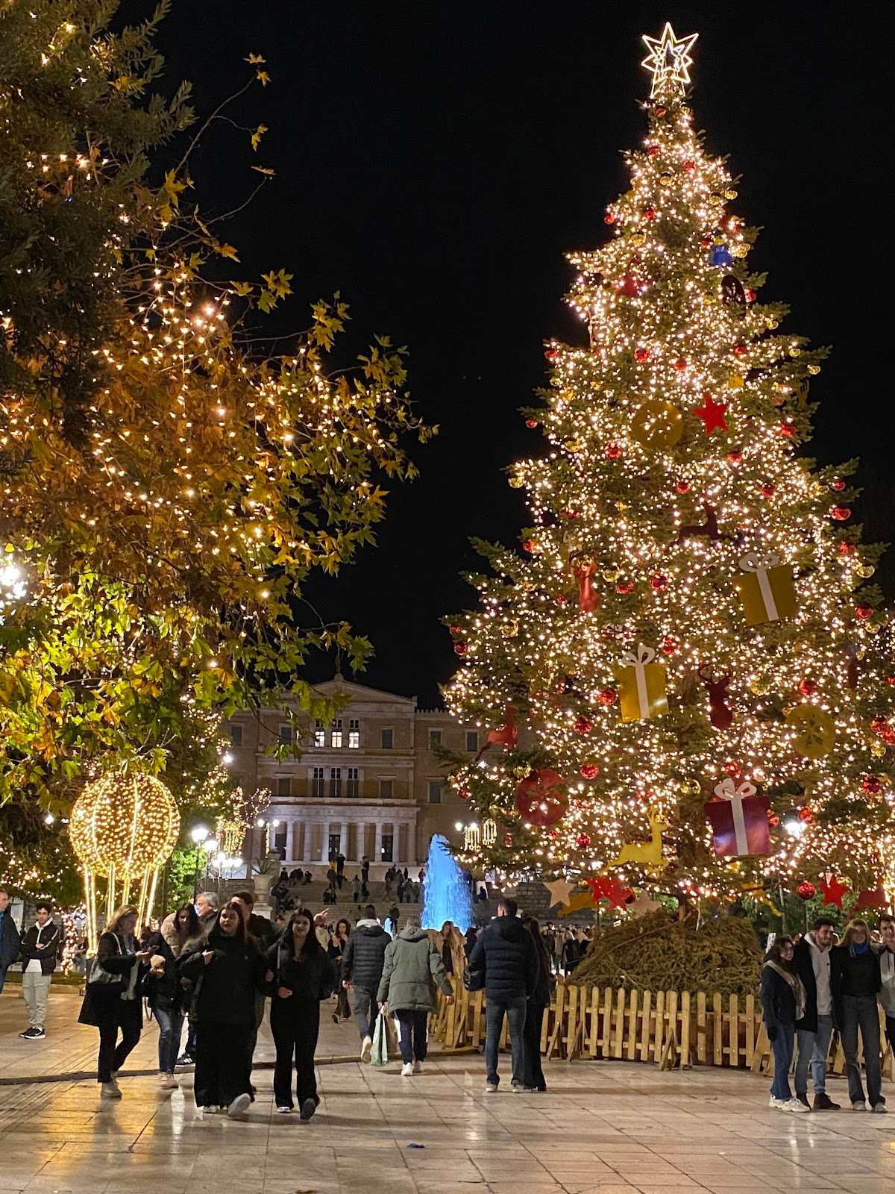
II Place – Antonis Koutsakis - Greece

Slide 6
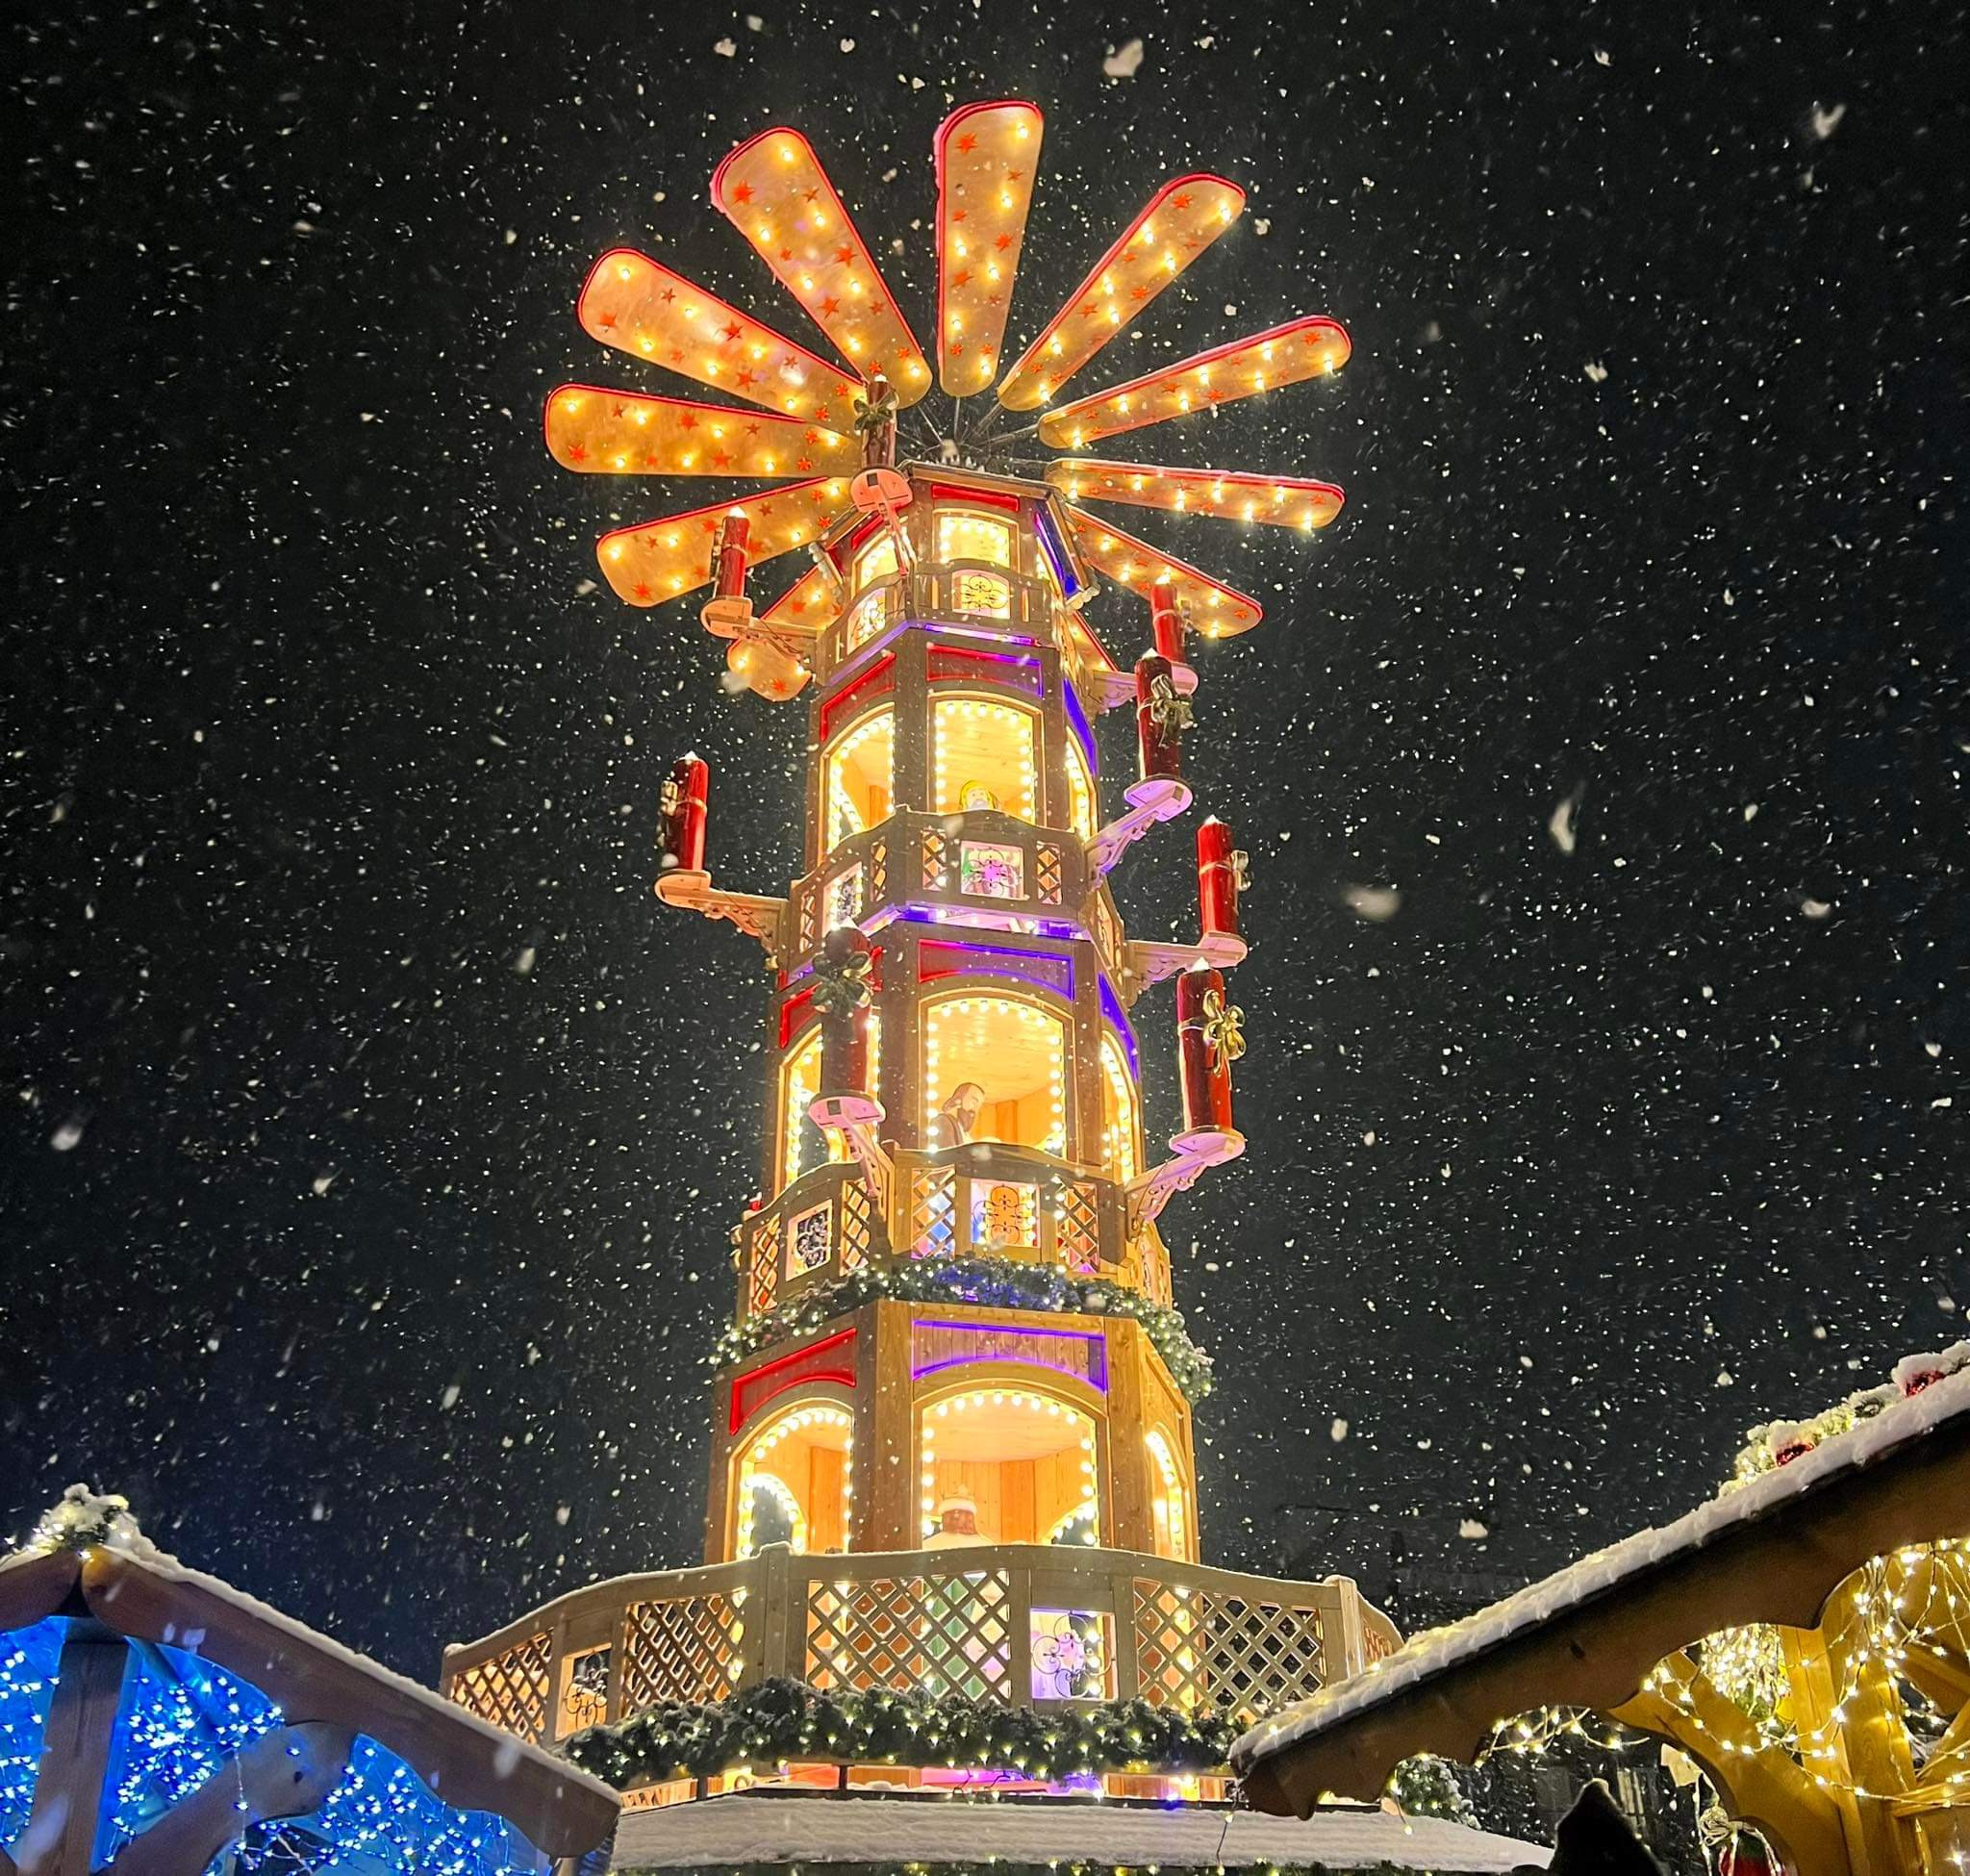
I Place – Olga Kwiatkowska - Poland

